Slide 1


Introducing the MVVM Toolkit, a .NET Standard library in the Windows Community Toolkit
Michael A. Hawker – Microsoft
Sergio Pedri – .NET Foundation

Slide 2



Who are we?
Michael A. Hawker
a.k.a. XAML Llama 🦙
Senior Software Engineer @ Microsoft
Maintainer of the Windows Community Toolkit
Created XAML Studio
Sergio Pedri
Computer Engineering Student, Master’s in ML/DL
Member of .NET Foundation & Toolkit Org
Creator of Toolkit’s MVVM & HighPerformance pkgs
Created Legere & OneLocker apps

Slide 3

Overview
Windows Community Toolkit
MVVM Toolkit
Demo
Q & A
#dotNETConf #MVVMToolkit
Notes:
Michael
If you have questions, tag them on Twitter with #dotNETConf and the #MVVMToolkit – We’ll answer them at the end.

Slide 4


Windows Community Toolkit
https://aka.ms/WCT
Suite of Controls, Extensions, and Helpers for Windows development
UWP & .NET Standard
Part of .NET Foundation, MIT Licensed
Lifetime Stats
Over 25 releases in 4 years
1,337+ Issues Closed
5+ Million NuGet Package Downloads
10,000+ Commits by 200+ contributors
Notes:
Michael

Slide 5
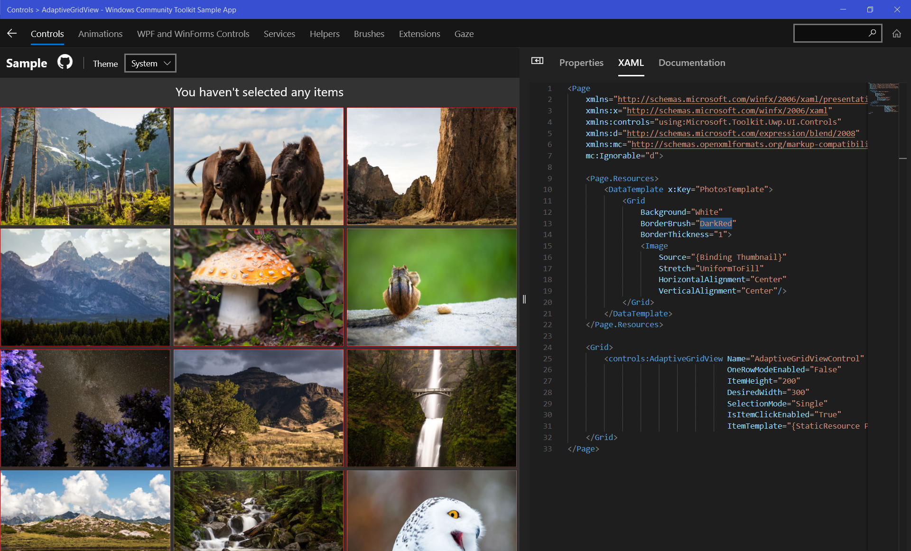
Get Started Today, Contribute Tomorrow!
Download Sample App from Microsoft Store
https://aka.ms/windowstoolkitapp
Documentation in App
Playground per Control/Helper/Service
Live edit XAML to test things out!
New Contribution Guide:
https://aka.ms/wct/wiki
Notes:
Pass off to Sergio doing MVVM intro

Slide 6
What is MVVM?
M – Model
V – View
VM – ViewModel
Notes:
Sergio - Preface: Making sure we’re on the same page, MVVM stands for Model, View, ViewModel. For this talk, we assume you are already familiar with the MVVM pattern.

Slide 7

Benefits of MVVM
Code Re-use
Platform Agnostic Behaviors
Testable
Separation for Design/Development
Notes:
Sergio

Slide 8


Introducing the MVVM Toolkit
Microsoft.Toolkit.Mvvm is a modern, fast, and modular MVVM library part of the Windows Community Toolkit
.NET Standard 2.0
Simple to pick-up and use
À la carte
Reference Implementation
Notes:
Michael

Slide 9
Why a new MVVM now?
MVVMLight and Caliburn.Micro no longer maintained
MVVMLight’s simplicity was missed for many we’ve talked to
Many frameworks have specific requirements for structure
Many advancements in .NET and Application Development since onset of most frameworks
Started in April 2020 driven by Community
Inspired by MVVMLight by Laurent Bugnion
We provide a starting point to build from
We’ve targeted .NET Standard and optimized for CPU & Memory usage
Notes:
Michael
Spiritual successor, Migration guide for MVVMLight

Slide 10
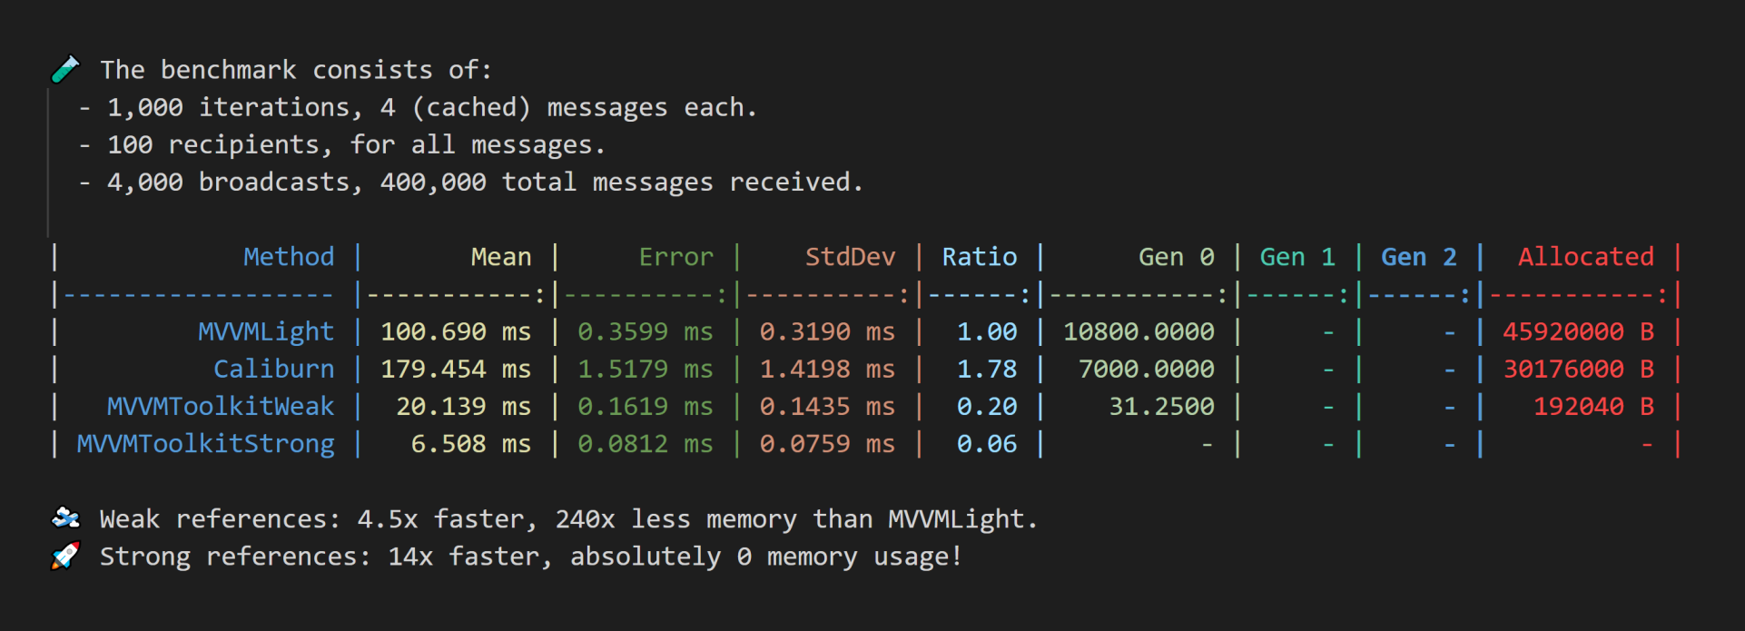

Metrics
Notes:
Michael

Slide 11

The MVVM Toolkit
ObservableObject (INotifyPropertyChanged)
RelayCommand [+Others] (ICommand)
Messenger [Pub/Sub]
Inversion of Control [IoC] (IServiceProvider)
Notes:
Sergio

Slide 12

MVVM Toolkit Demo
Sergio Pedri

Slide 13

… And More!
New Features
Support for wrapped models
Task notification w/ SetPropertyAndNotifyOnCompletion
ObservableValidator (INotifyDataErrorInfo)
2 new async Relay Commands (with cancellation support)
Added StrongReferenceMessenger implementation
Register to Messenger both manually and through interface
Notes:
Sergio –
Can call out we worked with the .NET Native team on the Task Notification part, and that we have a blog on it https://devblogs.microsoft.com/pax-windows/mvvm-toolkit-preview-3-the-journey-of-an-api/
Be sure to call out we worked with the WinUI team on the ObservableValidator

Slide 14

MVVM Toolkit Plans
Download Preview Today! aka.ms/mvvmtoolkit
Create Samples for more Platforms
Ship as part of 7.0 Release of the Windows Community Toolkit (2020)
Windows Template Studio Support (See WTS Issue #3753)
Notes:
Try it out!
Get Involved

Slide 15




Q & A
#dotNETConf #MVVMToolkit
@XAMLLlama
@SergioPedri

Slide 16

Thanks for joining!

